Slide 1
HEAP
A heap is a data structure that stores a collection of objects (with keys), and has the following properties:
  Complete Binary tree
  Heap Order
It is implemented as an array where each node in the tree corresponds to an element of the array.

Slide 2
HEAP
The binary heap data structures is an array that can be viewed as a complete binary tree. Each node of the binary tree corresponds to an element of the array. The array is completely filled on all levels except possibly lowest.
19
12
16
1
4
7
19
12
16
1
4
7
Array A

Slide 3
HEAP
The root of the tree A[1] and given index i of a node, the indices of its parent, left child and right child can be computed
PARENT (i)
return floor(i/2)
LEFT (i)
return 2i
RIGHT (i)
return 2i + 1

Slide 4
HEAP ORDER PROPERTY
For every node v, other than the root, the key stored in v is greater or equal (smaller or equal for max heap) than the key stored in the parent of v.
In this case the maximum value is stored in the root

Slide 5
DEFINITION
Max Heap
  Store data in ascending order
  Has property of
  A[Parent(i)] ≥ A[i]
Min Heap
  Store data in descending order
  Has property of
  A[Parent(i)] ≤ A[i]

Slide 6
MAX HEAP EXAMPLE
19
12
16
1
4
7
19
12
16
1
4
7
Array A

Slide 7
MIN HEAP EXAMPLE
1
4
16
7
12
19
1
4
16
7
12
19
Array A

Slide 8
INSERTION
Algorithm
  Add the new element to the next available position at the lowest level
  Restore the max-heap property if violated
    General strategy is percolate up (or bubble up): if the parent of the element is smaller than the element, then interchange the parent and child.
    OR
  Restore the min-heap property if violated
    General strategy is percolate up (or bubble up): if the parent of the element is larger than the element, then interchange the parent and child.

Slide 9
19
19
12
16
12
16
4
7
1
4
7
17
1
Insert 17
19
12
17
swap
1
4
7
16
Percolate up to maintain the heap property

Slide 10
DELETION
Delete max
  Copy the last number to the root ( overwrite the maximum element stored there ).
  Restore the max heap property by percolate down.
Delete min
  Copy the last number to the root ( overwrite the minimum element stored there ).
  Restore the min heap property by percolate down.

Slide 11
HEAP SORT
  A sorting algorithm that works by first organizing the data to be sorted into a special type of binary tree called a heap

Slide 12
PROCEDURES ON HEAP
Heapify
Build Heap
Heap Sort

Slide 13
HEAPIFY
Heapify picks the largest child key and compare it to the parent key. If parent key is larger than heapify quits, otherwise it swaps the parent key with the largest child key. So that the parent is now becomes larger than its children.
Heapify(A, i)
{
l ← left(i)
r ← right(i)
if l <= heapsize[A] and A[l] > A[i]
then largest ←l
else largest ← i
if r <= heapsize[A] and A[r] > A[largest]
then largest ← r
if largest != i
then swap A[i] ←→ A[largest]
Heapify(A, largest)
}

Slide 14
BUILD HEAP
We can use the procedure 'Heapify' in a bottom-up fashion to convert an array A[1 . . n] into a heap. Since the elements in the subarray A[n/2 +1 . . n] are all leaves, the procedure BUILD_HEAP goes through the remaining nodes of the tree and runs 'Heapify' on each one. The bottom-up order of processing node guarantees that the subtree rooted at children are heap before 'Heapify' is run at their parent.
Buildheap(A)
{
heapsize[A] ←length[A]
for i ←|length[A]/2 //down to 1
do Heapify(A, i)
}

Slide 15
HEAP SORT ALGORITHM
The heap sort algorithm starts by using procedure BUILD-HEAP to build a heap on the input array A[1 . . n]. Since the maximum element of the array stored at the root A[1], it can be put into its correct final position by exchanging it with A[n] (the last element in A). If we now discard node n from the heap than the remaining elements can be made into heap. Note that the new element at the root may violate the heap property. All that is needed to restore the heap property.
Heapsort(A)
{
Buildheap(A)
for i ← length[A] //down to 2
do swap A[1] ←→ A[i]
heapsize[A] ← heapsize[A] - 1
Heapify(A, 1)
}

Slide 16

EXAMPLE
First, we have to construct a heap from the given array and convert it into max heap.

Slide 17
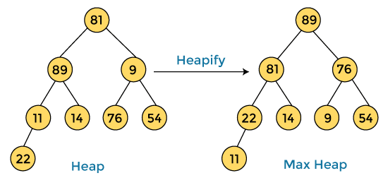

After converting the given heap into max heap, the array elements are -

Slide 18
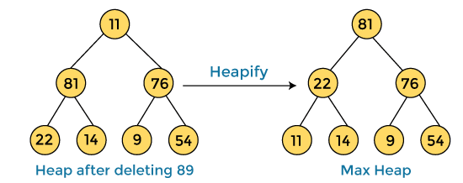

Next, we have to delete the root element (89) from the max heap. To delete this node, we have to swap it with the last node, i.e. (11). After deleting the root element, we again have to heapify it to convert it into max heap.
After swapping the array element 89 with 11, and converting the heap into max-heap, the elements of array are -

Slide 19
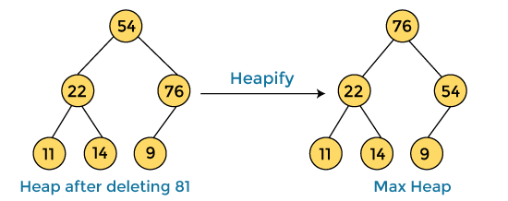

In the next step, again, we have to delete the root element (81) from the max heap. To delete this node, we have to swap it with the last node, i.e. (54). After deleting the root element, we again have to heapify it to convert it into max heap.
After swapping the array element 81 with 54 and converting the heap into max-heap, the elements of array are -

Slide 20
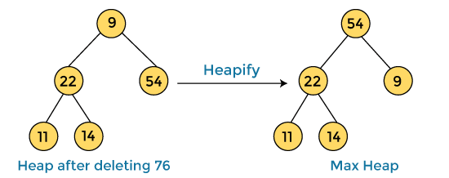

In the next step, we have to delete the root element (76) from the max heap again. To delete this node, we have to swap it with the last node, i.e. (9). After deleting the root element, we again have to heapify it to convert it into max heap.
After swapping the array element 76 with 9 and converting the heap into max-heap, the elements of array are -

Slide 21
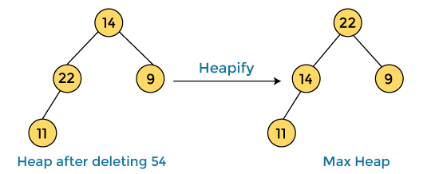

In the next step, again we have to delete the root element (54) from the max heap. To delete this node, we have to swap it with the last node, i.e. (14). After deleting the root element, we again have to heapify it to convert it into max heap.
After swapping the array element 54 with 14 and converting the heap into max-heap, the elements of array are -

Slide 22
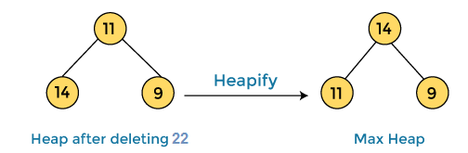

In the next step, again we have to delete the root element (22) from the max heap. To delete this node, we have to swap it with the last node, i.e. (11). After deleting the root element, we again have to heapify it to convert it into max heap.
After swapping the array element 22 with 11 and converting the heap into max-heap, the elements of array are -

Slide 23
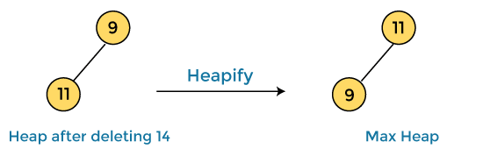

In the next step, again we have to delete the root element (14) from the max heap. To delete this node, we have to swap it with the last node, i.e. (9). After deleting the root element, we again have to heapify it to convert it into max heap.
After swapping the array element 14 with 9 and converting the heap into max-heap, the elements of array are -

Slide 24
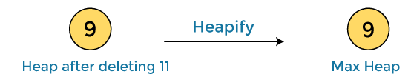

In the next step, again we have to delete the root element (11) from the max heap. To delete this node, we have to swap it with the last node, i.e. (9). After deleting the root element, we again have to heapify it to convert it into max heap.
After swapping the array element 11 with 9, the elements of array are -

Slide 25


Now, heap has only one element left. After deleting it, heap will be empty.
After completion of sorting, the array elements are -

Slide 26
TIME ANALYSIS
Build Heap Algorithm will run in O(n) time
There are n-1 calls to Heapify each call requires O(log n) time
Heap sort program combine Build Heap program and Heapify, therefore it has the running time of O(n log n) time
Total time complexity: O(n log n)

Slide 27
COMPARISON WITH QUICK SORT AND MERGE SORT
Quick sort is typically somewhat faster, due to better cache behavior and other factors, but the worst-case running time for quick sort is O (n²), which is unacceptable for large data sets and can be deliberately triggered given enough knowledge of the implementation, creating a security risk.
The quick sort algorithm also requires Ω (log n) extra storage space, making it not a strictly in-place algorithm. This typically does not pose a problem except on the smallest embedded systems, or on systems where memory allocation is highly restricted. Constant space (in-place) variants of quick sort are possible to construct, but are rarely used in practice due to their extra complexity.

Slide 28
COMPARISON WITH QUICK SORT AND MERGE SORT (CONT)
Thus, because of the O(n log n) upper bound on heap sort’s running time and constant upper bound on its auxiliary storage, embedded systems with real-time constraints or systems concerned with security often use heap sort.
Heap sort also competes with merge sort, which has the same time bounds, but requires Ω(n) auxiliary space, whereas heap sort requires only a constant amount. Heap sort also typically runs more quickly in practice. However, merge sort is simpler to understand than heap sort, is a stable sort, parallelizes better, and can be easily adapted to operate on linked lists and very large lists stored on slow-to-access media such as disk storage or network attached storage. Heap sort shares none of these benefits; in particular, it relies strongly on random access.

Slide 29
POSSIBLE APPLICATION
  When we want to know the task that carry the highest priority given a large number of things to do
  Interval scheduling, when we have a lists of certain task with start and finish times and we want to do as many tasks as possible
  Sorting a list of elements that needs and efficient sorting algorithm

Slide 30
CONCLUSION
The primary advantage of the heap sort is its efficiency. The execution time efficiency of the heap sort is O(n log n). The memory efficiency of the heap sort, unlike the other n log n sorts, is constant, O(1), because the heap sort algorithm is not recursive.
The heap sort algorithm has two major steps. The first major step involves transforming the complete tree into a heap. The second major step is to perform the actual sort by extracting the largest element from the root and transforming the remaining tree into a heap.

